Slide 1
ME 233 Advanced Control II Lecture 5 Least Squares Estimation
(ME233 Class Notes pp. LS1-LS5)
TexPoint fonts used in EMF.
Read the TexPoint manual before you delete this box.: AAAAAAAAAAAA

Slide 2
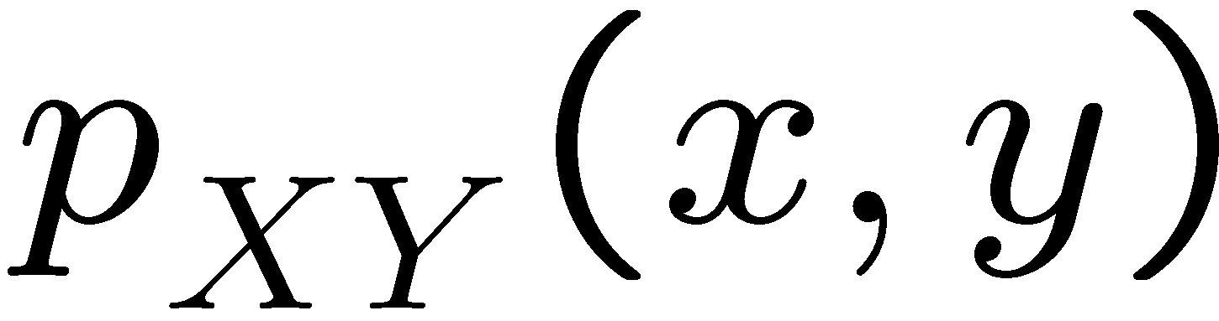
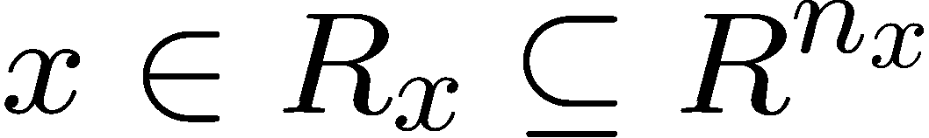

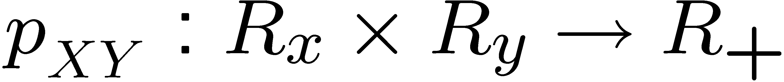
Notation
Let X and Y be continuous random vectors with joint PDF
Let x and y be respectively outcomes of X and Y and

Slide 3
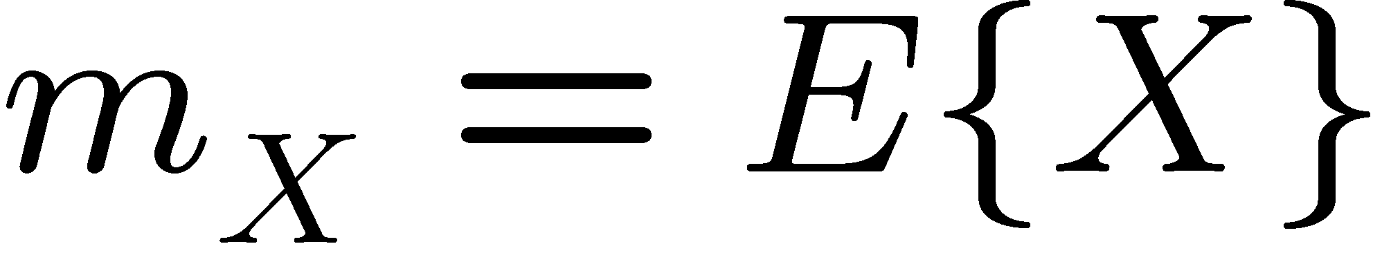
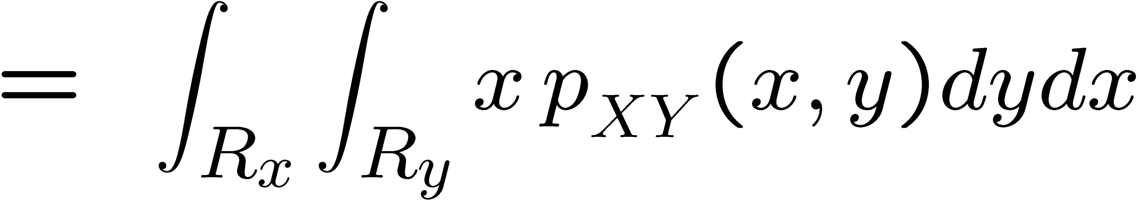
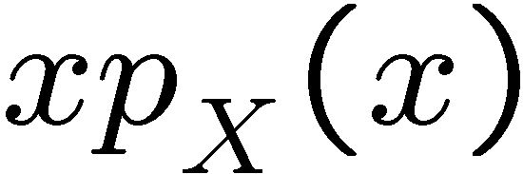
Marginal Expectation (review)
Let X and Y be continuous random vectors with joint PDF
Marginal Expectation (mean) of X

Slide 4
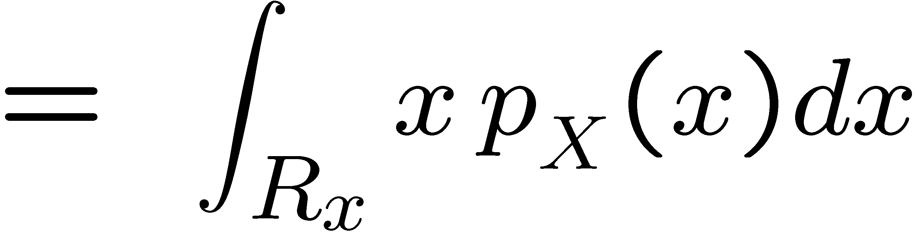

Marginal Expectation (review)
Let X and Y be continuous random variables with joint PDF
Marginal Expectation (mean) of X
new notation
(following the ME233 class notes)

Slide 5

Marginal Expectation
is the minimum least squares
marginal estimator of X, i.e.
For any deterministic vector z
Euclidean norm

Slide 6

Marginal Expectation
Proof:
0

Slide 7
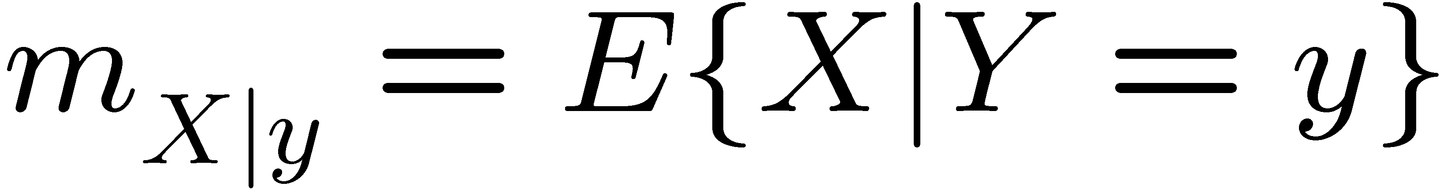
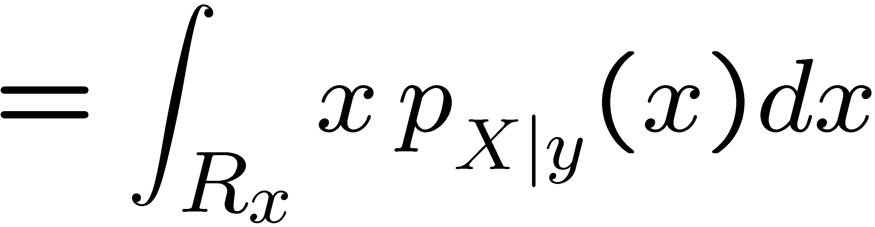
Conditional Expectation (review)
Let X and Y be continuous random vectors with joint PDF
Conditional Expectation (conditional mean)
of X given and outcome Y = y

Slide 8
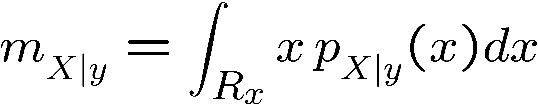
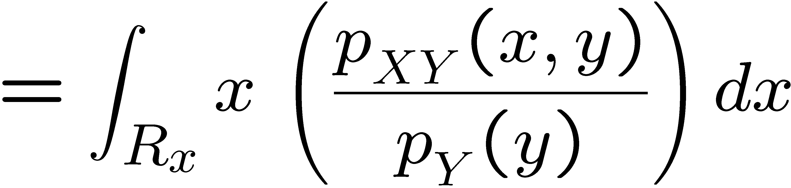

Conditional Expectation (review)
Conditional Expectation (conditional mean)
of X given and outcome Y = y
new notation
(following the ME233 class notes)

Slide 9
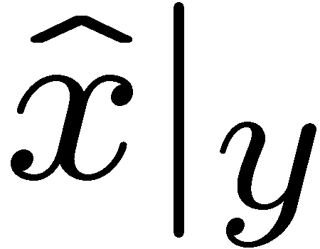
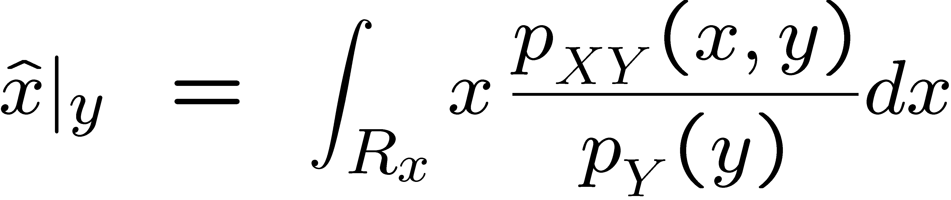
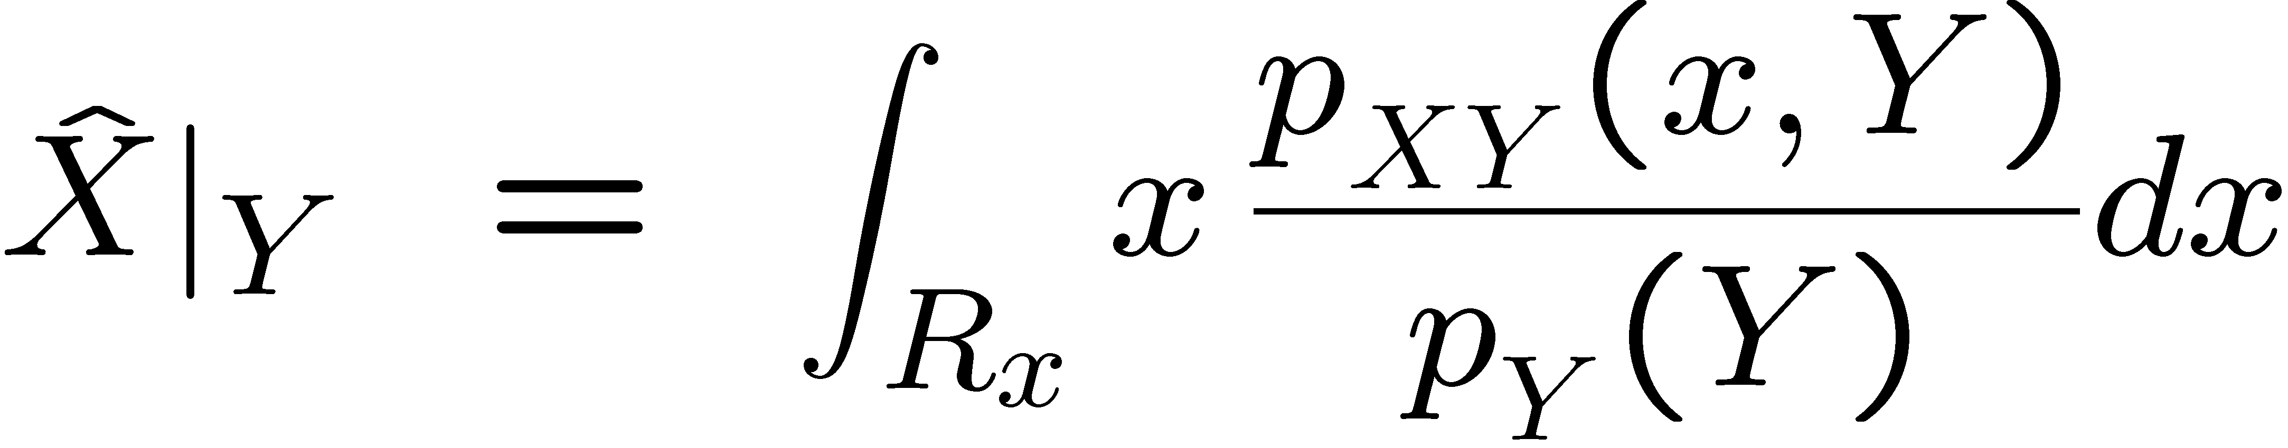
Conditional Expectation
Notice that the conditional expectation
can be interpreted as a function of the random variable Y.

Slide 10


Conditional Expectation
Lemma:
For any function of the random vector Y, with the appropriate dimensions
we can replace X by its conditional expectation

Slide 11
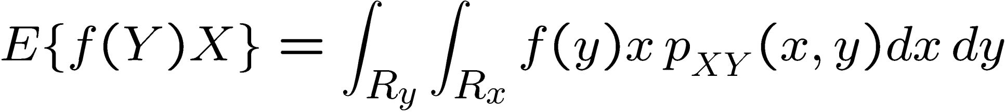
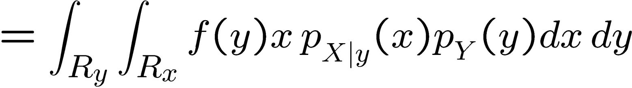
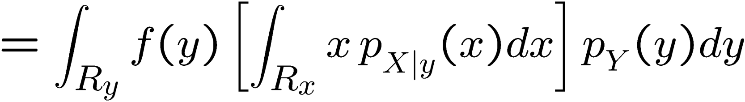
Marginal Expectation
Proof:
First examine the left-hand side:

Slide 12
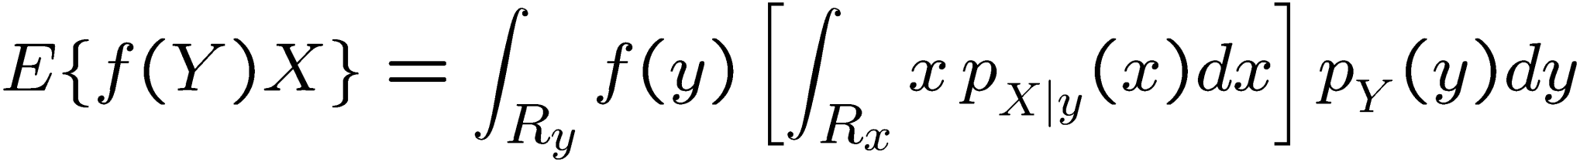
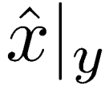
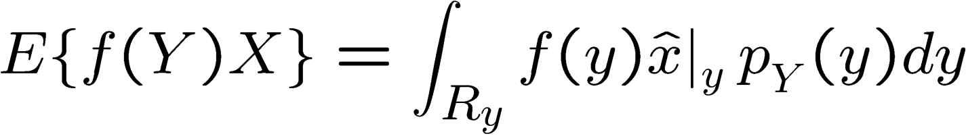
Marginal Expectation
Proof:
First examine the left-hand side:

Slide 13
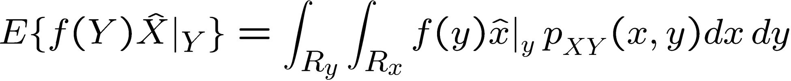
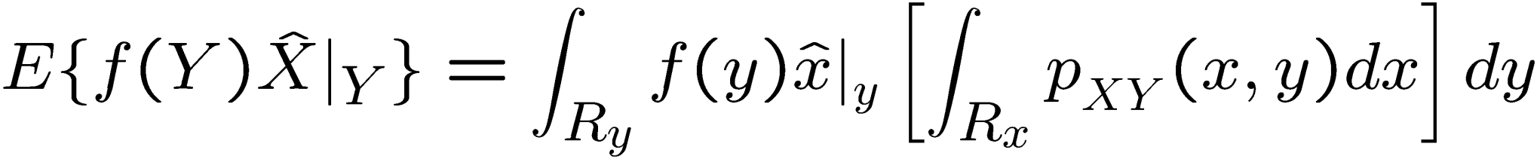

Marginal Expectation
Proof:
Now examine the right-hand side:
Not a function of x

Slide 14
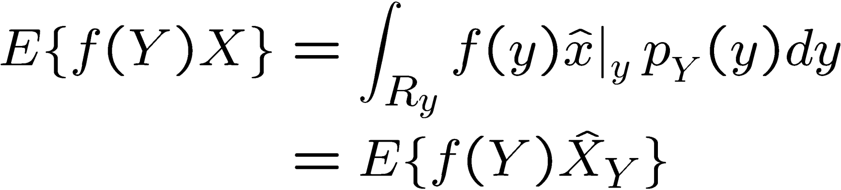
Marginal Expectation
Proof:
Therefore,

Slide 15
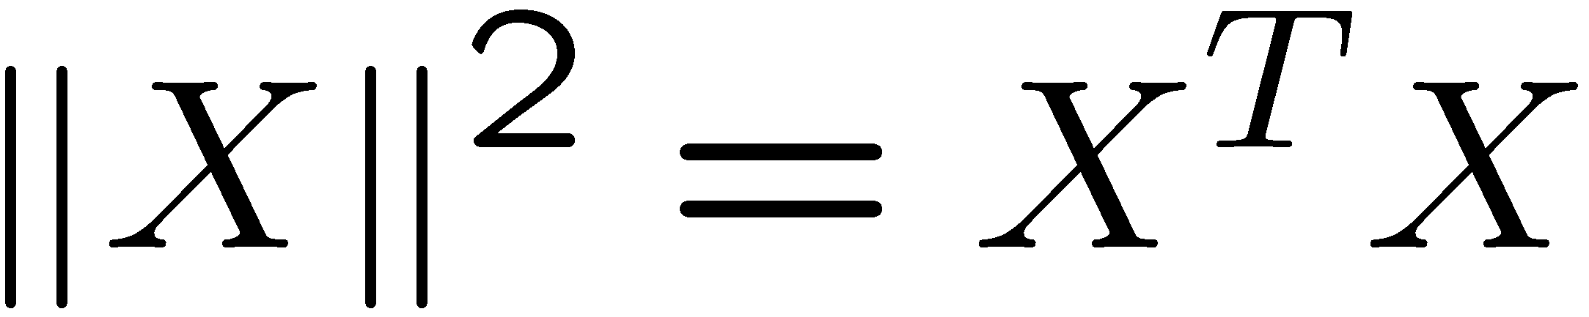
Conditional Expectation
Theorem:
is the least squares minimum estimator of X given Y, i.e.
for all functions of Y of appropriate dimensions

Slide 16
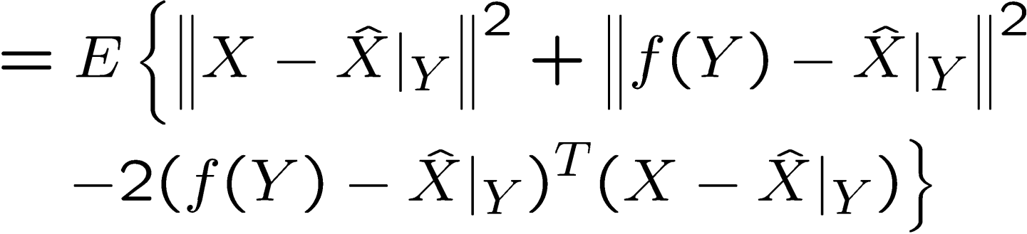
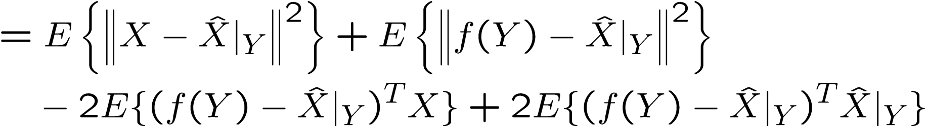
Marginal Expectation
Proof:

Slide 17

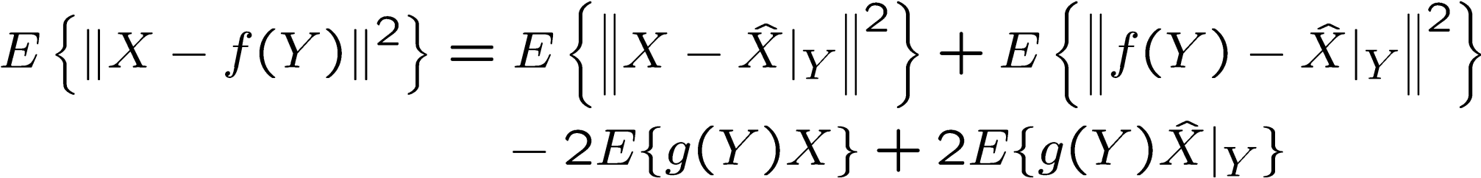


Marginal Expectation
Proof:
Define
0
Since for all outcomes,

Slide 18
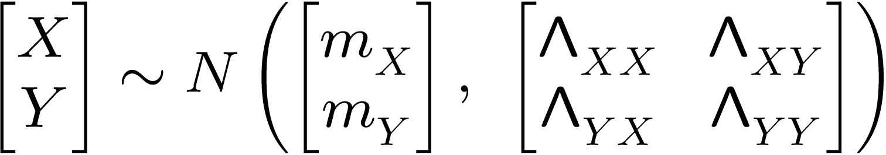
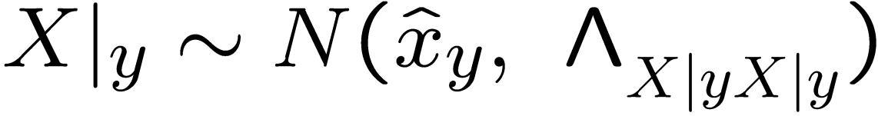
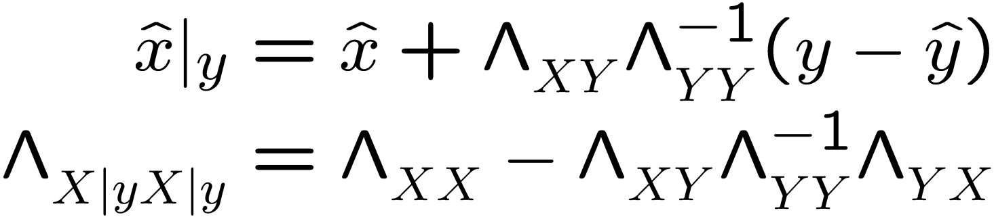
Conditional Expectation for Gaussians (review)
When
where

Slide 19
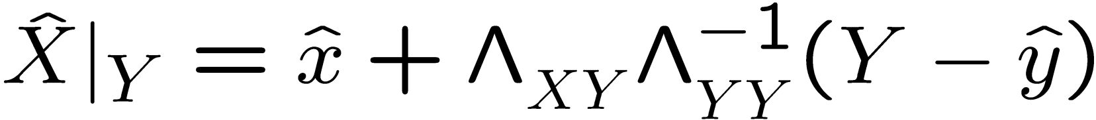
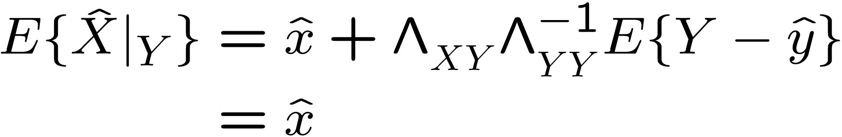
Conditional Mean for Gaussians
When
0

Slide 20
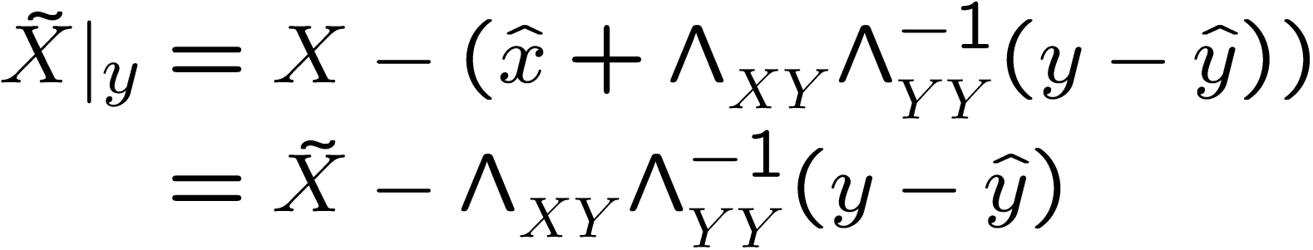
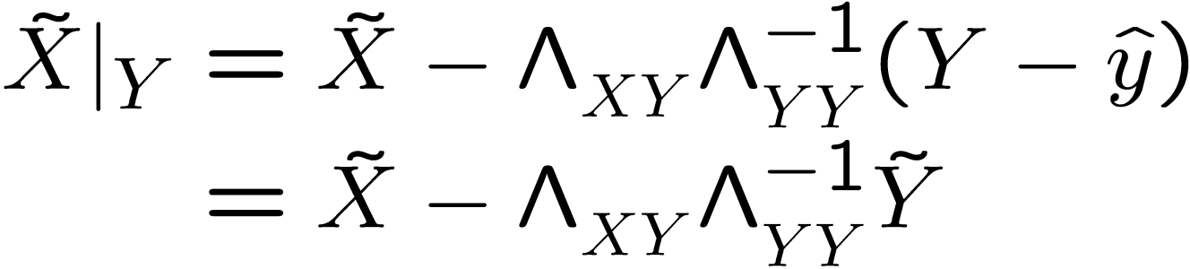
Conditional Mean for Gaussians
When

Slide 21
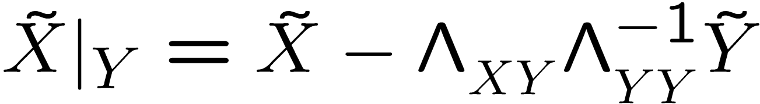
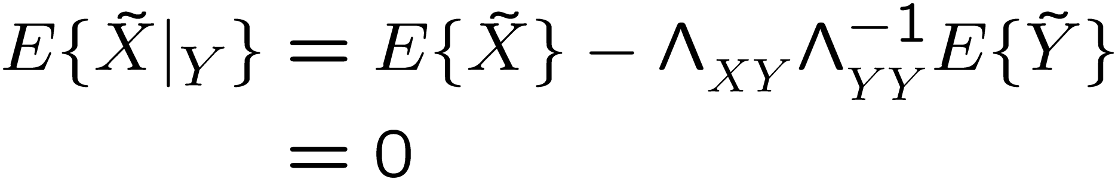
Conditional Mean for Gaussians
When
0
0

Slide 22
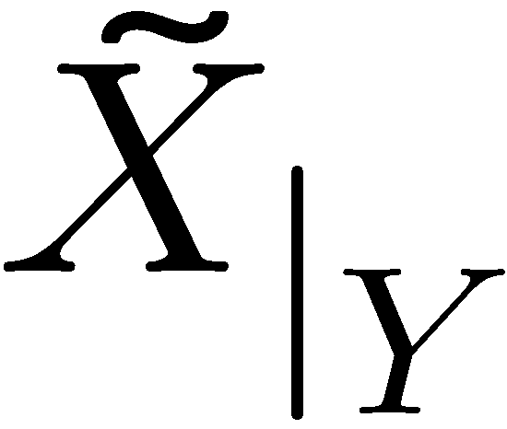

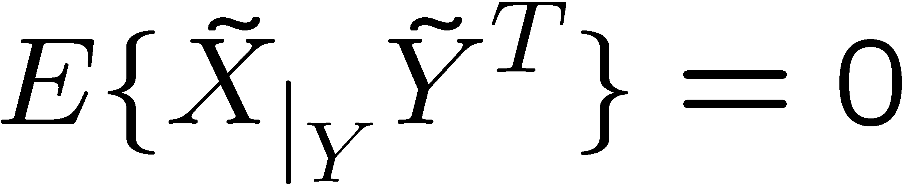
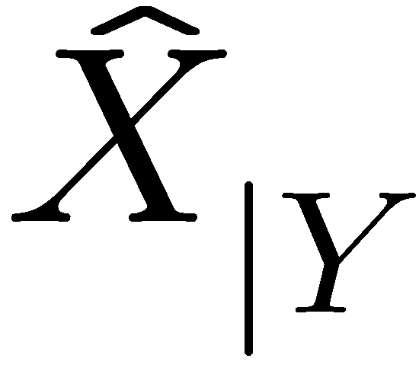
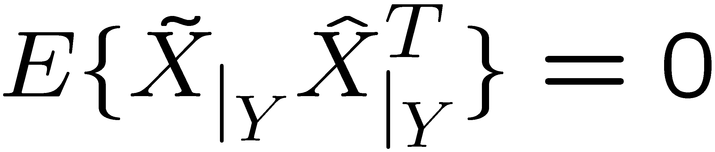
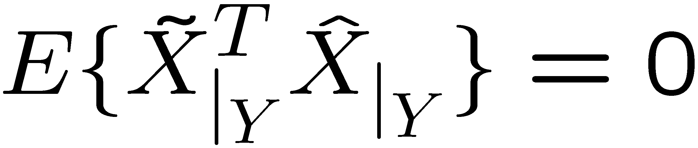
Least Squares Estimation: Property 1
The conditional estimation error and are uncorrelated
and are orthogonal
and

Slide 23
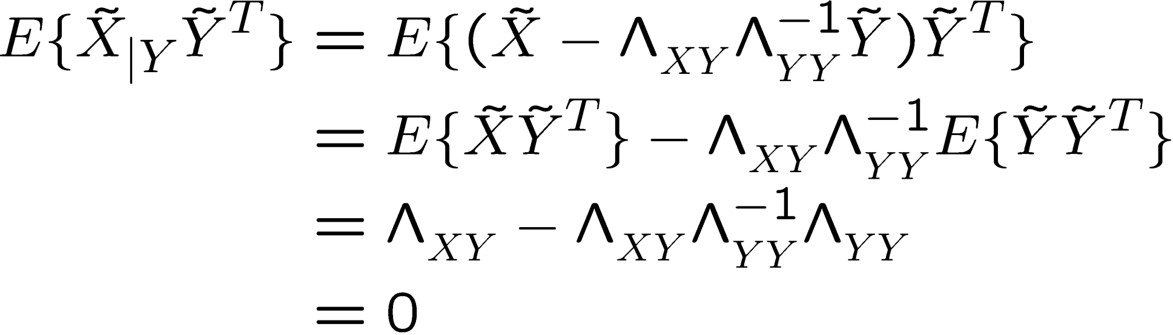
Least Squares Estimation: Property 1
Proof

Slide 24
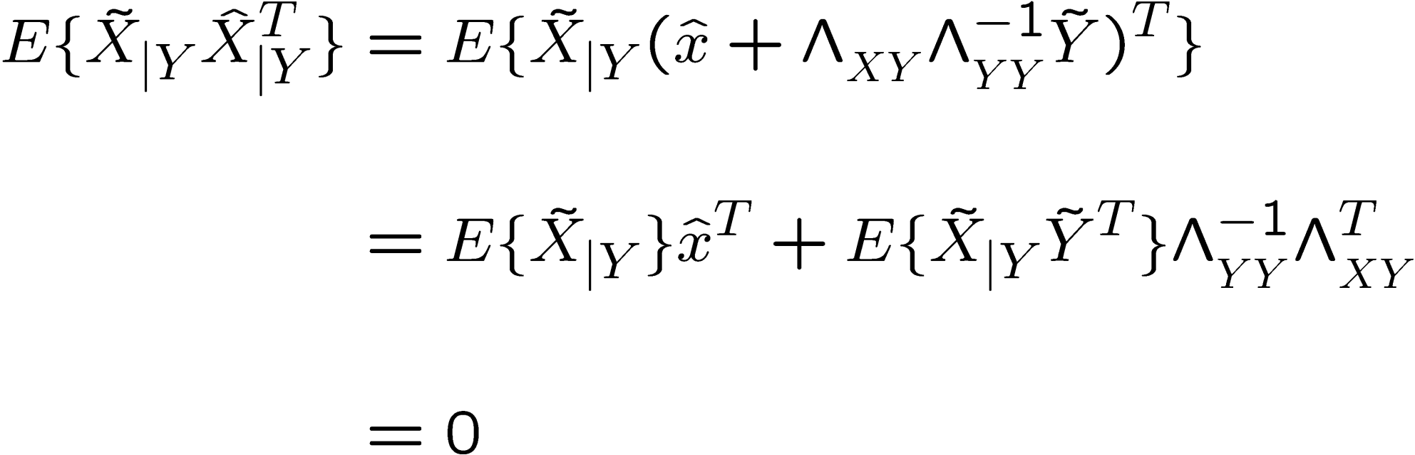
Least Squares Estimation: Property 1
Proof
0
0

Slide 25
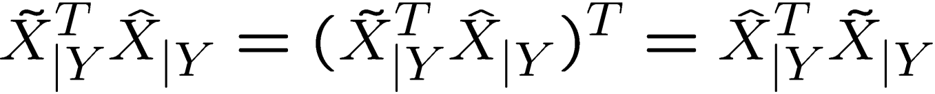
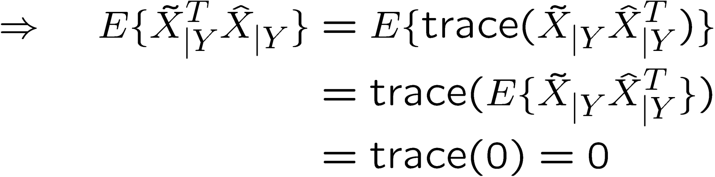
Least Squares Estimation: Property 1
Proof
scalar
Why does trace
commute with
expectation?

Slide 26

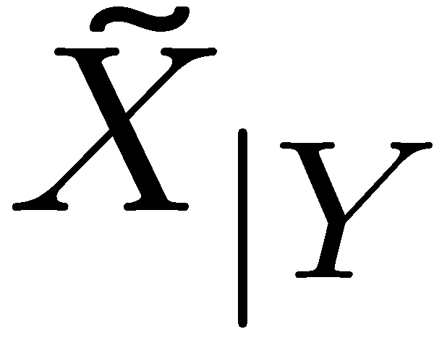

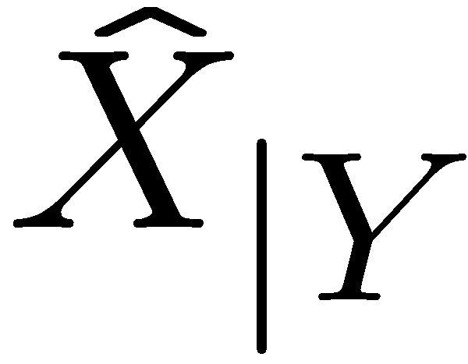
Deterministic interpretation of Property 1

Slide 27
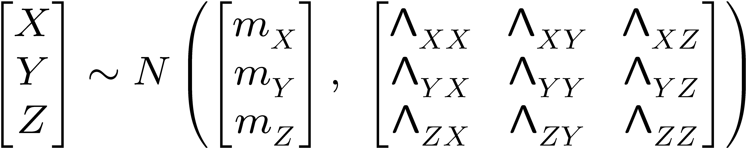
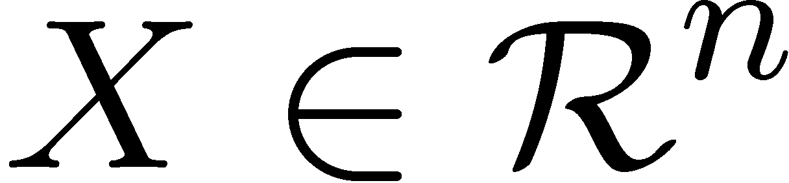





Recursive LS Estimation
Let X , Y and Z be jointly Gaussian R.V.s

Slide 28
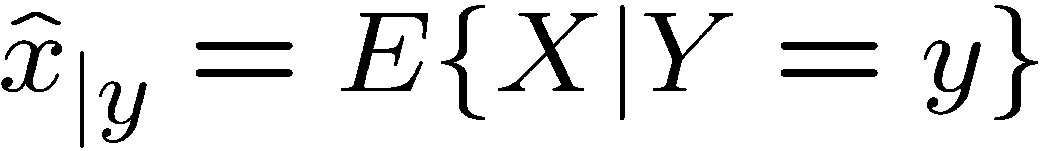


Recursive LS Estimation
Assume that we already know of outcome Y = y
and we have obtained
inverse of an M × M matrix

Slide 29

Recursive LS Estimation
Assume that we already know of outcome Y = y
and we have obtained
2. Now we also know the outcome Z = z
How do we efficiently compute
?

Slide 30





Non-Recursive LS Estimation
1) Define the vector
2) Compute
inverse of an (p+M) × (p+M) matrix

Slide 31






Least Squares Estimation: Property 2
Assume that
Then,
where

Slide 32




Deterministic interpretation of Property 2

Slide 33





Least Squares Estimation: Property 2
Proof:
0
0
because Z and Y
are uncorrelated

Slide 34









Least Squares Estimation: Property 2
Proof:

Slide 35



Least Squares Estimation: Property 2
Proof:

Slide 36


Least Squares Estimation : Property 3
What happens when Z and Y are correlated?
Then,
This warrants further explanation…

Slide 37




Recursive LS Estimation
Using Y , we can estimate X and Z by their conditional means:
The conditional mean of X
The conditional mean of Z
The corresponding conditional estimation errors are:
Uncorrelated withY (by Least Squares Property 1)

Slide 38


Recursive LS Estimation
We have:
The conditional mean of X
The conditional mean of Z
If we get the outcomes Y=y and Z=z
The corresponding conditional estimation errors become:
This is still random
This is now an outcome

Slide 39



Deterministic interpretation of Property 3

Slide 40


Computation of
where:

Slide 41




Least Squares Estimation : Property 3
a) Recursive estimate
where:

Slide 42



Least Squares Estimation : Property 3
b) Recursive estimation error
where:

Slide 43

Derivation of Recursive LS Estimation
1) Define the vector
2) Compute
inversion of an (p+M) × (p+M) matrix

Slide 44






Solution: use Schur complement
Given
and
Compute the Schur complement of
which is the conditional covariance

Slide 45



Solution: use Schur complement of
Given
Then

Slide 46


Non-Recursive LS Estimation

Slide 47



Use Schur complement

Slide 48


Use Schur complement

Slide 49

Use Schur complement
expected value of X given outcome y

Slide 50



Use Schur complement
We will now show that
The expected value of given the outcome

Slide 51



Computation of
The conditional mean of Z given Y = y :

Slide 52





Computation of
Therefore,
We will now compute using the LS result:
to verify that

Slide 53
Computation of
Using Gaussian least squares results:
0
Estimation errors always have zero means

Slide 54





Computation of
Using Gaussian least squares results:
the conditional covariance

Slide 55


Computation of
Using Gaussian least squares results:
Notice that, from the Schur complements result,

Slide 56



Computation of
Using Gaussian least squares results:
0

Slide 57







Computation of
Using Gaussian least squares results:

Slide 58

Computation of
Therefore,
and

Slide 59

Non-Recursive LS Estimation Error

Slide 60


Use Schur complement

Slide 61


Use Schur complement

Slide 62

Summary
The conditional mean is the least squares estimator:
For Gaussians, the conditional mean is an affine function

Slide 63

Summary
The conditional mean can be computed recursively:
If we first know of outcome Y = y

Slide 64

Summary
The conditional mean can be computed recursively:
2 If we afterwards know of outcome Z = z
then

Slide 65
Course Outline
Finished
Unit 0: Probability
Unit 1: State-space control, estimation
Unit 2: Input/output control
Unit 3: Adaptive control

